Slide 1

“Am I a Data Scientist?” Finding My Identity Through Unsupervised Learning
Project-4 @ METIS
Jhonsen Djajamuliadi

Slide 2

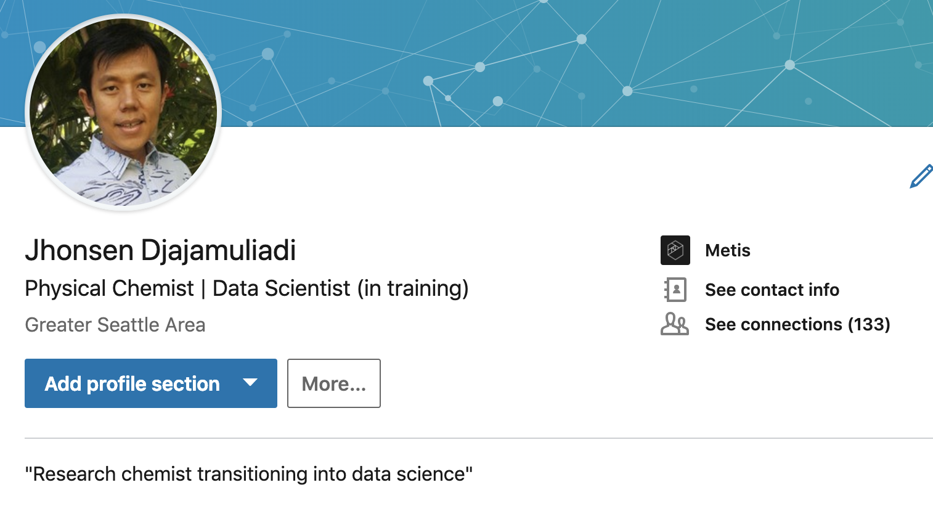


My Journey in Becoming a Data Scientist
“Hard Skills ”
“Soft Skills ”
How should I describe myself?
How should I network?
How should I negotiate?
Figure from https://towardsdatascience.com/introduction-to-statistics-e9d72d818745
Notes:
Could I find a pattern in the way that data scientist

Slide 3
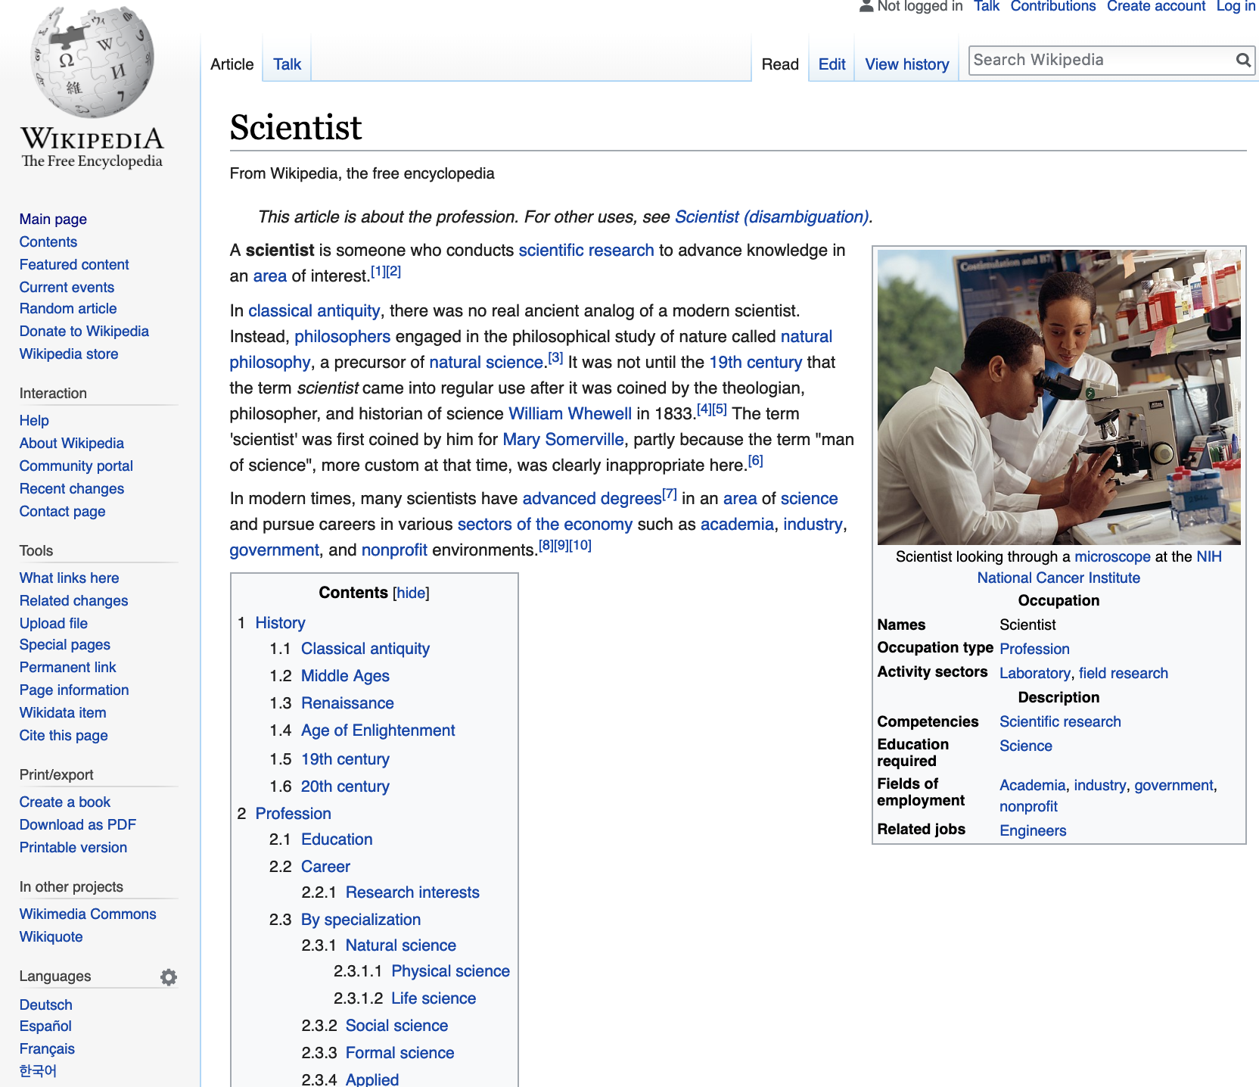
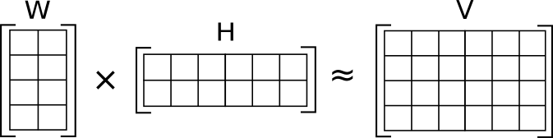
Seeking My Identity in Wikipedia Articles
What is a data scientist?
Is it similar to other scientists?
Data Collection
Natural Language Processing
Category: Scientists
~15,000 articles x 1.2 million words
Unsupervised Learning
Non-negative Matrix Factorization
Dimensionality reduction
“Topics” in documents
scientists
Deployed Application
words

Slide 4
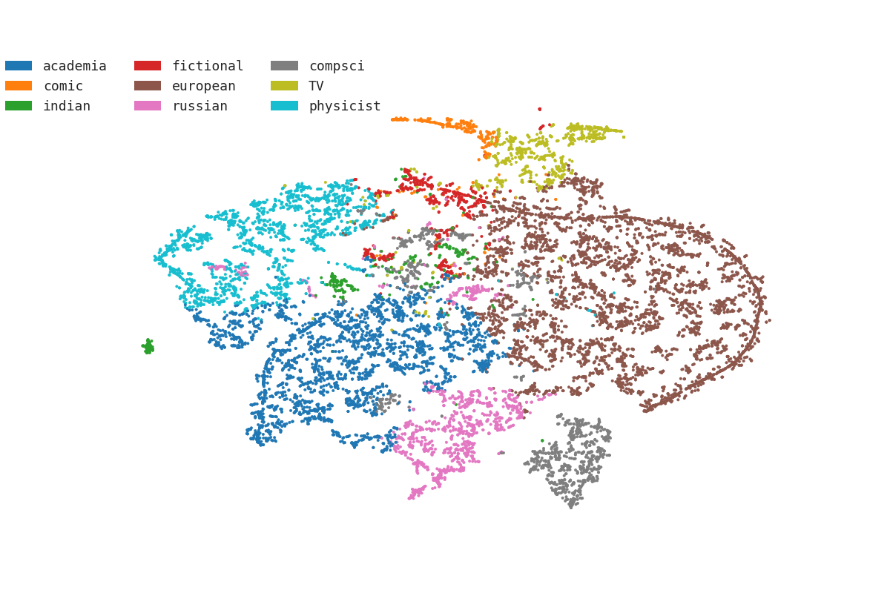
Finding Topics in Summaries
Topic Modeling
characters
star trek
soviet
created star trek
characters television
russian
trek
star
created
university
academy
television
series
fictional
television series
professor
academy sciences
chinese
created star
character
fictional
research
member
department
sciences
characters
institute
academician
scientist
characters television series
science
director
computing
computer
born
institute
german
science
computer scientist
known
director
indian
april
february
computer science
comic books published
august
physics
science
french
marvel
academy
work
march
theory
comics
comic
scientific
august
quantum
comic books
sciences
india
physicist
indian science
theoretical
prize
books published
research
nobel
nobel prize
american comic books
academy sciences
appearing american comic

Slide 5
Finding Structure Among Scientists
Topic Modeling and 2D-Embedding with T-SNE
t-Distributed Stochastic Neighbor Embedding (t-SNE)^{[1]}
Each point – a scientist
Colors – heaviest topic-weights
Distances ∝ similarity
[1] T-SNE, https://lvdmaaten.github.io/tsne/

Slide 6
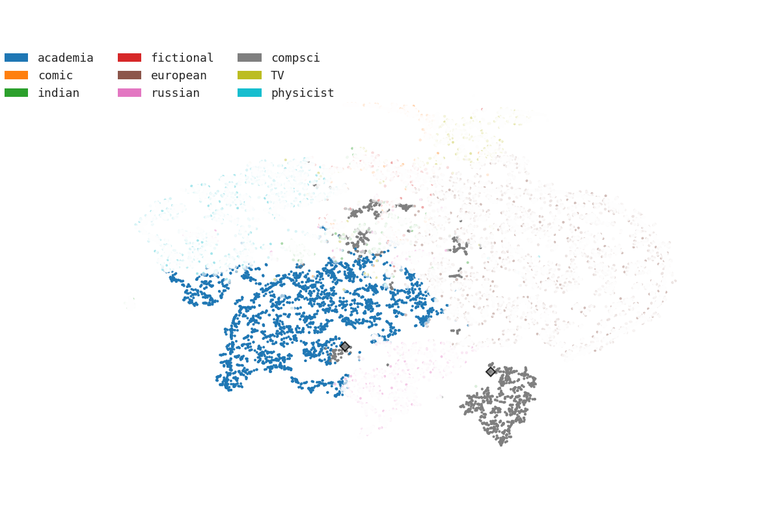
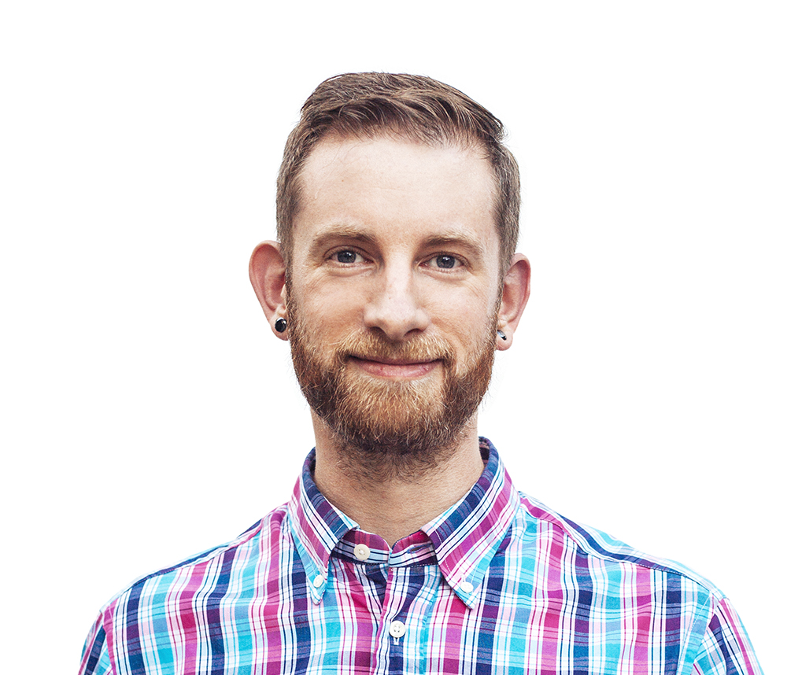
Finding Structure Among Scientists
Topic Modeling and 2D-Embedding with T-SNE
Hadley Wickham
Chief Scientist, Rstudio
R Developer
Adjunct Professor
Academia
Computer/Data Scientist

Slide 7
Finding (Cosine)-Similarity with Others
Topic Modeling and 2D-Embedding with T-SNE
Jhonsen Djajamuliadi
Research Chemist
Data Scientist
Machine Learning
Ricardo Bianchini
Microsoft Research
American Computing Fellow
Data & Server Management
“Am I a Data Scientist?”
vs.
Similarity ~ 0.95
Academia
We say: YES!!!
Computer/Data Scientist

Slide 8
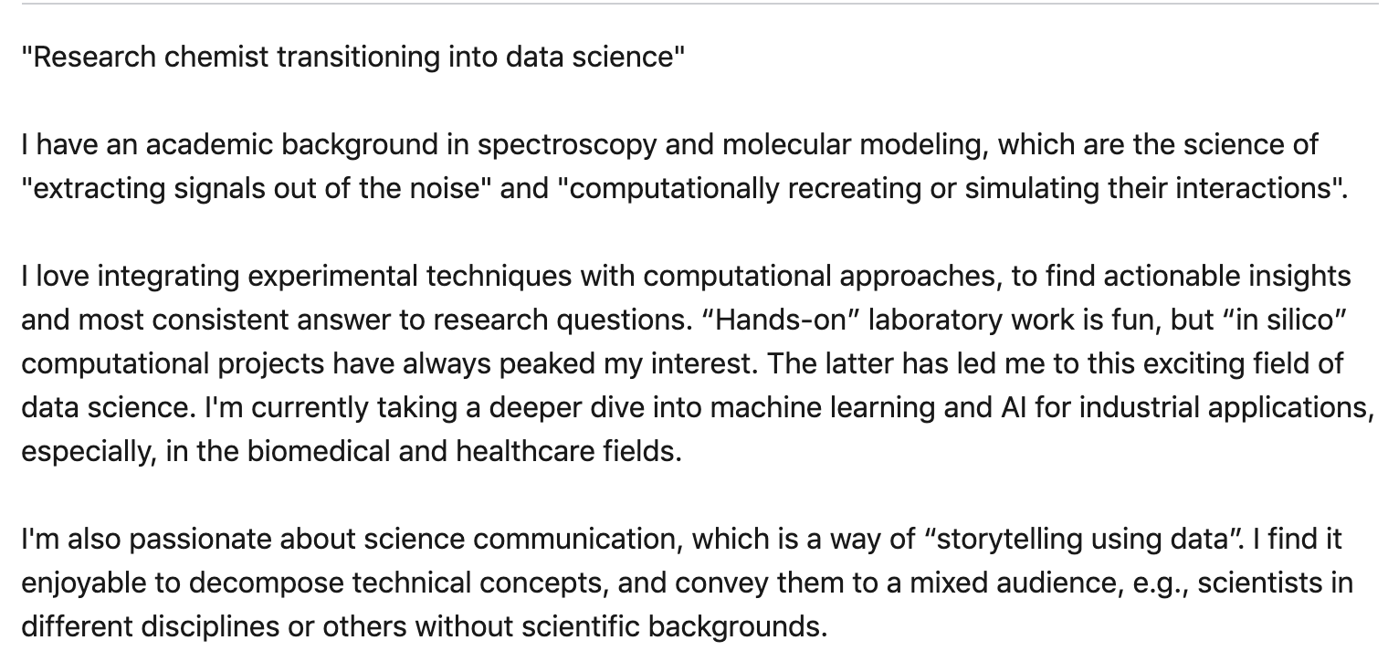

Web Application in Development
Input:
Summary
Output:
Top 10 (or n-) similar scientists
Ricardo Bianchini
Ricardo Bianchini from Rutgers University & Microsoft Research, Bellevue, WA was named Fellow of the Institute of Electrical and Electronics Engineers (IEEE) in 2015^{[1]} for contributions to server and data center energy management. He was named an Association for Computing Machinery (ACM) Fellow in 2016 ^{[2]} for contributions to power, energy and thermal management of servers and datacenters.
Future Work:
“Cleaner data”, LinkedIn
Target data science domain
Application to Industry:
Tool for company recruiters
“New feature” on LinkedIn
“Am I a Data Scientist?”
“Are you a good fit?”

Slide 9





Candidates
Employers
Thank You
Physical Chemist | Research Scientist |
Data Analyst | Data Scientist
jhonsen
jhonsen
jhonsen_dj

